Slide 1

Creating and fostering a workplace culture to drive disability inclusion
Kim Jeffreys, Senior Manager, DEI, People & Culture
and
W. Francis Fung, National Manager, Rehabilitation and Clinical Services / IDEA Co-Lead for Engagement and Employment Support Systems Hub Lead
Notes:
Intro from Dan

Slide 2
Webinar description
Ad hoc inclusion efforts and policies are less effective in changing the experience of people with disabilities in the workplace without creating and fostering a disability inclusion culture
Notes:
KJ

Slide 3
Purpose of webinar
Highlight important concepts and elements for workplace parties to consider in their disability inclusion journey
Discuss strategies and intentional efforts to create and foster a disability inclusive workplace culture within an organization
Notes:
KJ

Slide 4
Agenda
Why is workplace culture change essential for disability inclusion
Social Model of Disability at the center of disability inclusion
Accessibility, Universal Design, Accommodation
  Principles for destigmatization
Beyond the usual suspects: best practice tools to advance workplace disability inclusion
  Lesser-known practices to advance workplace disability inclusion
Ensuring sustainability
  Accountability - measuring, monitoring and evaluating change
Questions and Answers
Notes:
KJ

Slide 5
Acknowledgments
Dr. Emile Tompa, Executive Director of IDEA, Director of CRWDP, Associate Professor at McMaster University, and Senior Scientist at Institute for Work & Health
Dr. Rebecca Gerwurtz, Director of IDEA, and Associate Professor, School of Rehabilitation Science at McMaster University
Logan Wong, Research Assistant at McMaster University, Lived Experience Consultant at CanChild Centre for Childhood Disability Research
Alec Farquhar, Co-Lead for Engagement, IDEA, Lawyer, a member of the steering committee for Disability and Work Canada
Amy Swenson-Tiano, Chief Accessibility Officer and Vice President, Information Technology and Digital Innovation, March of Dimes Canada
Notes:
KJ

Slide 6
Why is culture change essential for disability inclusion?
Notes:
FF

Slide 7
What is Disability Inclusion?
Principles:
"Nothing without us"
Human rights-based approach
Intersectionality
Disability inclusion is not just hiring more People with disabilities
Notes:
FF

Slide 8
What are the benefits of being disability inclusive?
Business case -
Commonly recognized benefits
Lesser-known benefits
Notes:
FF

Slide 9
What is workplace culture (aka organizational culture)?
Organizational culture is a multidimensional, multilevel construct
Organization’s mission and philosophy may not be consistent with its actual norms and physical environment
Notes:
FF

Slide 10
Why do we need a workplace culture change?
Disability inclusion goes beyond legal compliance
“Fitting people in” - Job matching and matching values to workplace culture
Societal culture evolving, disability inclusion is a journey
Changing policies and procedures alone won’t be enough, need to start with a culture shift
Notes:
FF

Slide 11
What are the goals of disability inclusion?
Integration (We vs They)
Fit – personal values and organization values
Flexibility
Language/Terms - normalize, combat ableism and tokenism
Disability Inclusion preparedness
Notes:
FF

Slide 12
Impactful strategies to enable a workplace culture of disability inclusion
Notes:
KJ

Slide 13
Models of disability that most effectively fosters disability inclusion
Theoretical models that offer frameworks to enhance understanding about disability inclusion approaches
The Social Model of disability – strengths, weaknesses and why it’s the most effective model to advance disability inclusion
Notes:
KJ

Slide 14
Accessibility, Universal Design, Accommodation
How they can work in harmony to drive a culture of disability inclusion
Framework for destigmatizing accommodation
Notes:
KJ

Slide 15
Principles of mental health destigmatization that can be adapted to destigmatize disability accommodation
Normalize the Conversation – Awareness and Dialogue
Leadership Training
Breaking Down Stereotypes
Confidentiality and Trust
Flexibility and Personalization
Communication Campaigns
Employee Resource Groups & Allies
Proactive and Preventative Approaches
Normalizing Accommodation as Routine Practice
Notes:
KJ

Slide 16
Best practice and tools to advance workplace disability inclusion
Best practices – the usual suspects:
Leadership
Vision and Mission
Policies
Education
Networks
Communication
Feedback
Representation
Decision-Making
Metrics
Accountability
Sense of Belonging
Positive Portrayal
Work Environments
Innovation
Collaboration
Community Engagement
Notes:
KJ

Slide 17
Best Practice: unusual suspect
An uncommon, impactful best practice to advance workplace disability inclusion:
Accessibility Lens Tool – embedding universal design principles in all employment activities
Notes:
KJ

Slide 18
How to ensure sustainability?
Accountability
Measuring culture change
  Process indicators
  Results indicators
Monitoring and Evaluation
Notes:
FF

Slide 19
Summary
Notes:
FF

Slide 20
References
Baykal, E. (2020). Organizational-Cultural Elements for Improved Workplace Performance of Disabled Individuals, Handbook of Research on Positive Organizational Behavior for Improved Workplace Performance (pp.240-259). https://psycnet.apa.org/record/2019-78359-014
Breward, K. (2017). Individual, Organizational, and Institutional Predictors of the Granting of Employer-sponsored Disability Accommodations https://cjds.uwaterloo.ca/index.php/cjds/article/view/383/617
Canadian Centre for Diversity and Inclusion (2018). The ROI of Diversity and Inclusion.
Center for Talent Innovation (2017). Disabilities and Inclusion.
Conference Board of Canada (2019). Employers' Toolkit: Making Ontario Workplaces Accessible to People With Disabilities. https://www.conferenceboard.ca/product/employers-toolkit-making-ontario-workplaces-accessible-to-people-with-disabilities-2nd-edition/
EU-OSHA (2019). Healthy Workplaces for All Ages. https://osha.europa.eu/en/tools-and-resources/e-guides/e-guide-all-ages
Government of Canada (2022). Canada’s Disability Inclusion Action Plan, https://www.canada.ca/en/employment-social-development/programs/disability-inclusion-action-plan/action-plan-2022.html
Iwanaga, K., Chan, F., Ditchman, N., & Tansey, T. N. (2021). Assessing Workplace Culture and Disability Inclusion Climate: A Preliminary Study. Journal of Applied Rehabilitation Counseling, 52(1), 34–50. https://doi.org/10.1891/JARC-D-20-00001
Kirsh, B. & Gewurtz, R. (2012). Mental Health Issues Related to Health Versus Non-Healthy Workplaces. Handbooks in Health, Work, and Disability.
Kirsh, B. & Gewurtz, R. (2011). Organizational Culture and Work Issues for Individuals with Mental Health Disabilities.
Krentz, M., Wierzba, O., & Garcia-Alonso, J. (2019). How to Improve Your Company’s Approach to Mental Health. Harvard Business Review.
Tompa, E., Mofidi, A., Irvin, E., Gewurtz, R. (2022). Development of an Indicator Framework in Relation to Culture Change Towards Accessibility and Inclusion of Persons with Disabilities. Institute of Work & Health.
Wasman, D. (2015). Employing Persons with Disabilities: A Model of Success Corporate Culture Change. https://drpi.research.yorku.ca/asia-pacific/drpi-aware/
Notes:
FF

Slide 21
Stay in touch
Ways to continue the conversation:
  Join the IDEA distribution list, email info@vraie-idea.ca
    learn about upcoming events such as the Speaker Series and hear about new tools and resources IDEA is promoting
    provide information on promising initiatives
    participate in a pilot project
    participate in scaling up innovations
  Join March of Dimes Canada (MODC) Disability Advocacy Network, https://www.marchofdimes.ca/en-ca/aboutus/govtrelations/dan
  Contact Kim Jeffery via email kjeffreys@marchofdimes.ca
  Contact W Francis Fung via email ffung@marchofdimes.ca
Notes:
FF

Slide 22
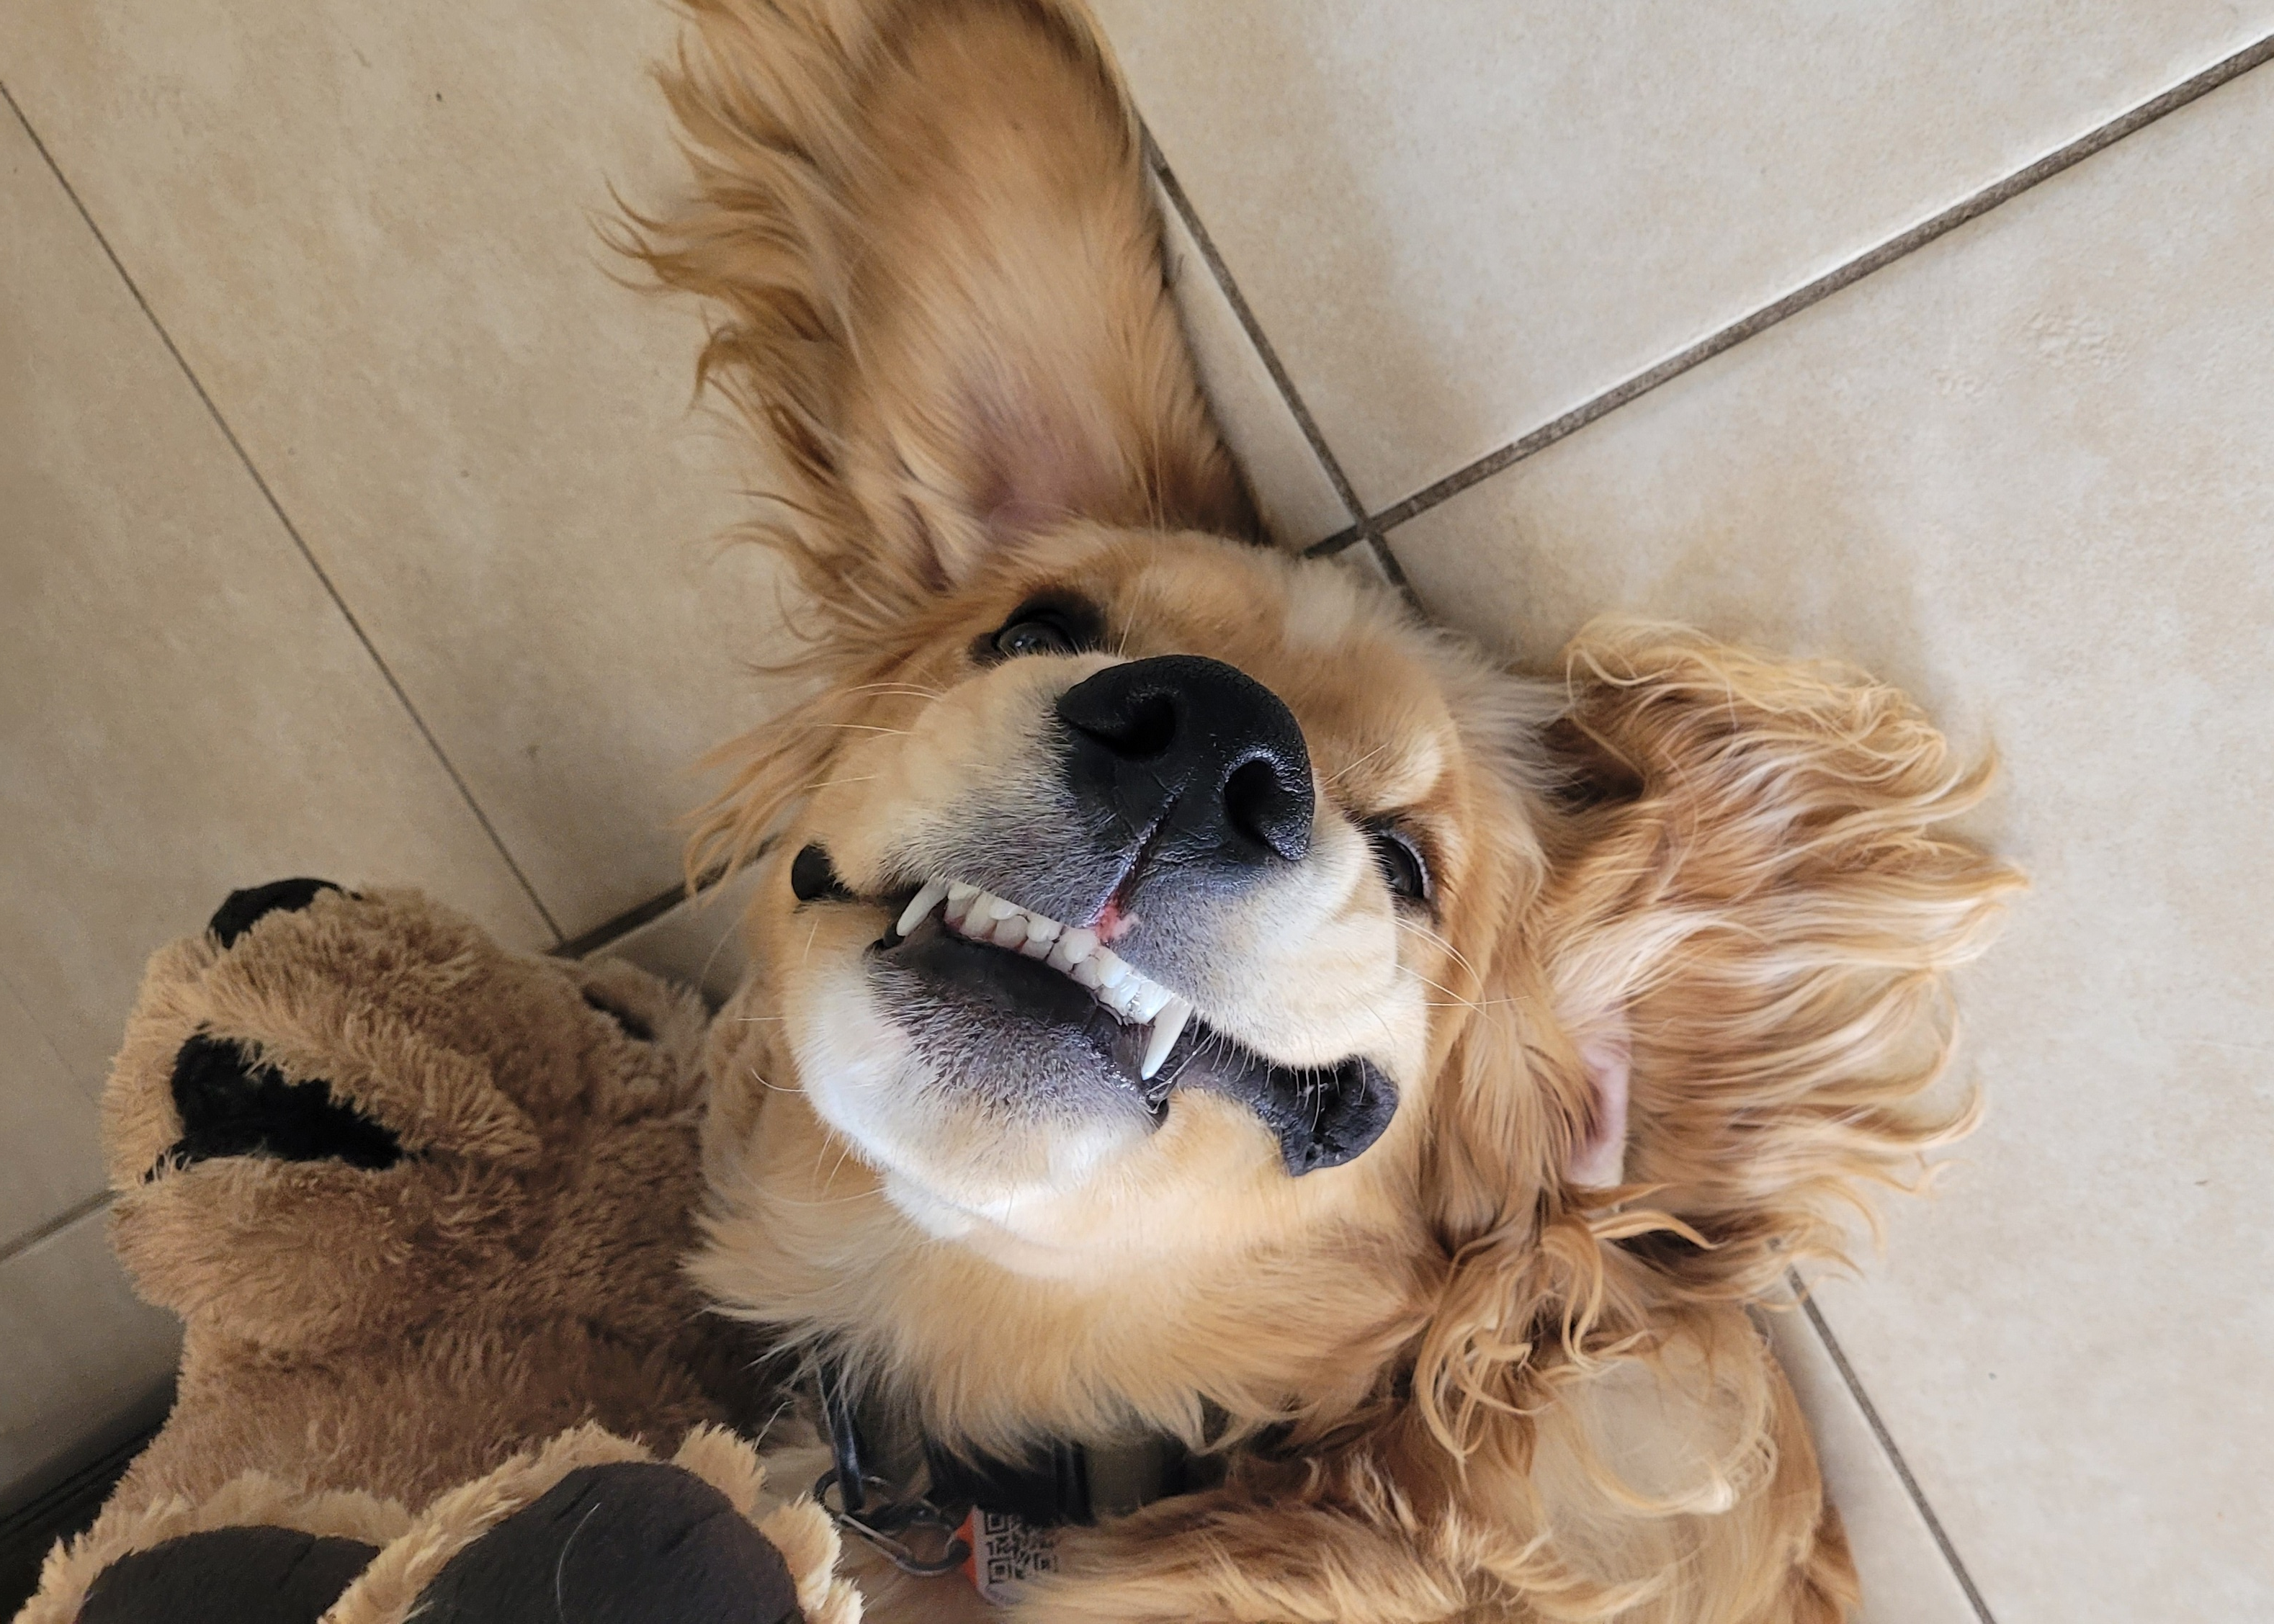
Questions and Answers
If you can't think of a question now, maybe you can help answer this one:
You get a dog to help with your anxiety, but your dog also has anxiety, so now what do you do?
Caption: A golden retriever spaniel lying on its back and appears to be smiling
Notes:
Back to Dan

