Slide 1
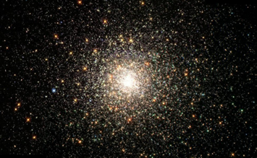
Addressing the Risks & Opportunities of Artificial Intelligence
Jutta Treviranus
Inclusive Design Research Centre
OCAD University
Toronto, Canada
The ancestral and traditional territories of the Mississaugas of the Credit, the Hauenosaunee, the Anishinaabe & the Huron-Wendat
Attribution-NonCommercial 4.0 International License

Slide 2
Ursula Franklin’s Technology:
"Technology involves organization, procedures, symbols, new words, equations, and, most of all, a mindset."

Slide 3
“progress at the speed of trust”

Slide 4
“…trust us to break things, to make mistakes, to push forward.”

Slide 5
disability & technology

Slide 6
“for most people, technology makes things convenient, if you have a disability, technology makes things possible.”

Slide 7
To speak, read, write, learn, effect the world, navigate the world, eat, express love, remember, plan, breathe, ….live

Slide 8
If you have a disability the opportunities and risks are at the extremes

Slide 9
Extreme Opportunities..
Recognize speech, gestures, patterns
Find a target object or pattern
Match and label objects
Remember forever and remind on time
Sort possible paths to find the optimum
Detect common mistakes and correct them

Slide 10
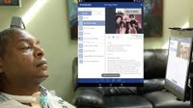
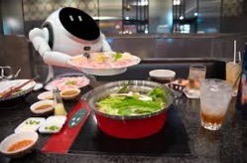
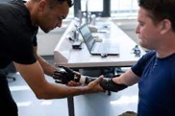
Mechanizing the Formulaic..

Slide 11
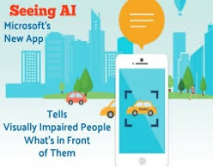
Current AT..
Image to text description (e.g., Be My Eyes, Seeing AI, JAWS PictureSmart AI)
Real-time captioning (e.g., Zoom, TranscribeGlass)
Sound filtering (e.g., Orka Two)

Slide 12
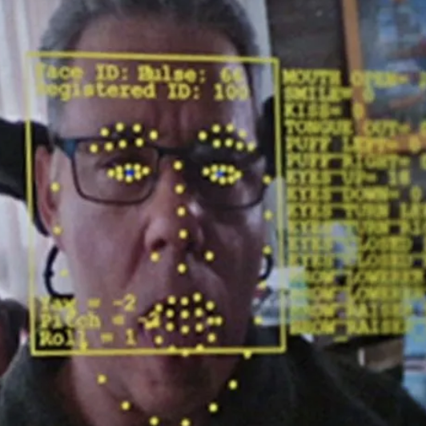
More Current AT..
Voice control (e.g., Voiceitt)
Personal Voice Output (e.g., Apple Personal Voice)
Exoskeleton optimization (e.g., Stanford E.)
Gesture Control (e.g., Cephable, The Wheelie)

Slide 13
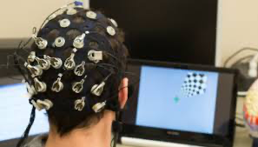
…and More Current AT
Smart home systems, & robotic assistants
Memory & recall (e.g., Rewind AI)
Simplification & Summation (e.g., Detangle AI)
Writing support (e.g., Chat GPT)….
Brain Computer Interface

Slide 14
….and more
Assessment tools
Monitoring and evaluation tools
Training and configuration tools

Slide 15
The flies in the ointment..

Slide 16
AI in Assistive Technology
Privacy breaches and data abuse and misuse
Surveillance and manipulation
Homogenization
Inverse benefits
Connectivity
Hallucination

Slide 17
Privacy Breaches
Inaccessible terms of service
Data sharing – who else gets the data?
Cloud AI vs. on-device AI

Slide 18
Surveillance & manipulation
AT user and others
Targeted advertising
Stereotypical optimization metrics

Slide 19
Homogenization
Impact of “being typical”
Loss of differentiation

Slide 20
Inverse Benefits
Works the worst for people that need it the most
Assumed accommodation

Slide 21
Connectivity
Cost of bandwidth
Power consumption and sustainability

Slide 22
Hallucination
Sounding believable, not telling the truth
“Producing believable bull**”

Slide 23
What data about disability have we fed AI?
Ablist slurs
Disabled people as inferior, unattractive, tragic victims, suffering
Bad jokes about disability
Benevolent ableism – “inspiration porn”

Slide 24
Toxicity Censors
Captioning toxicity filters
Facial difference cancellation
Disability without sex

Slide 25
Less known risk: an infrastructure of disability discrimination

Slide 26
Generations of AI
First: “here are the rules, follow then literally and accurately”
Second: “here is available data, use statistical reasoning to optimize the selected metrics”
Third: “here is all the data we have, you figure it out and make new connections and determine weights based on past relationships and possible combinations.”

Slide 27
Finding, matching, sorting, labeling, measuring, optimizing, calculating, analyzing people… at scale

Slide 28
there is a problem.. & we are the collateral damage

Slide 29
the problem precedes AI

Slide 30
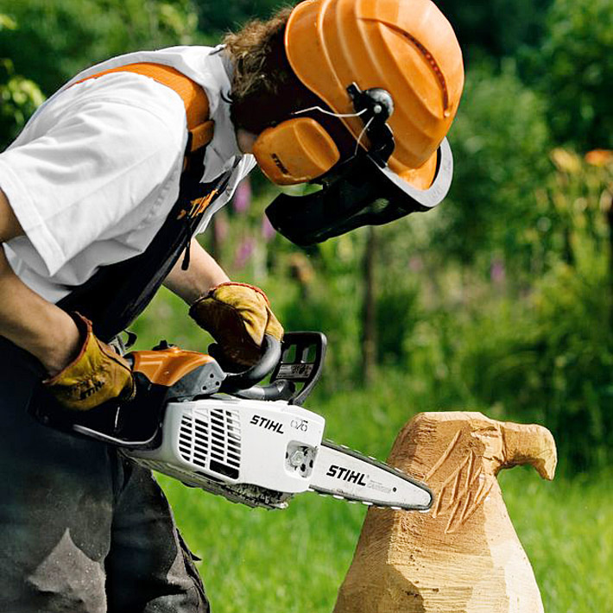
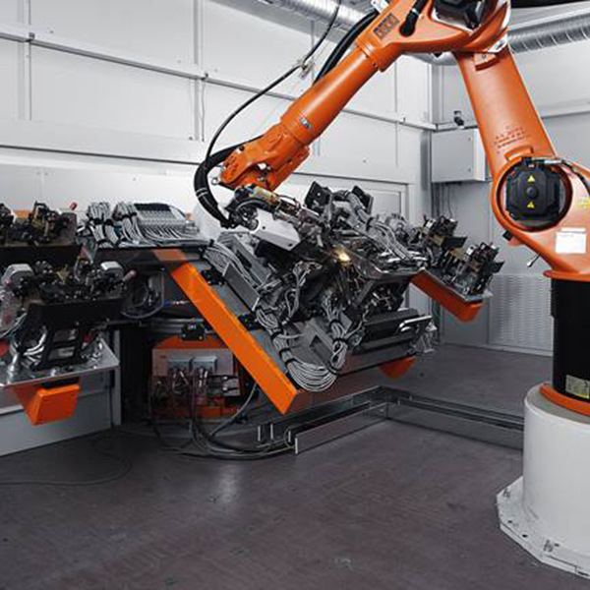
AI is a power tool…

Slide 31
AI is mechanizing, accelerating, amplifying, and automating existing patterns

Slide 32
More efficiently, accurately, consistently..

Slide 33
..propagating discrimination faster, more efficiently, and accurately

Slide 34
missed by AI ethics efforts

Slide 35
existential flaw..

Slide 36
my first alarm…

Slide 37
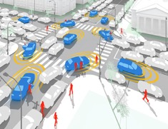
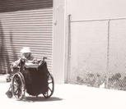
Alice and the unexpected…
Notes:
.

Slide 38
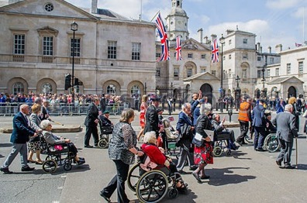
Smarter is not always better…
Notes:
.

Slide 39
My data set of human requirements….

Slide 40
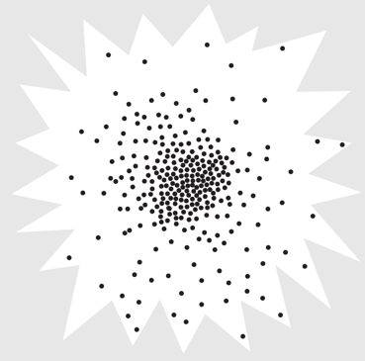
Our human starburst…
Notes:
.

Slide 41
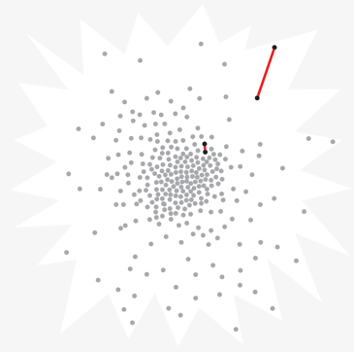
Difference…

Slide 42
Human Starburst and Design

Slide 43
Human Starburst and AI

Slide 44
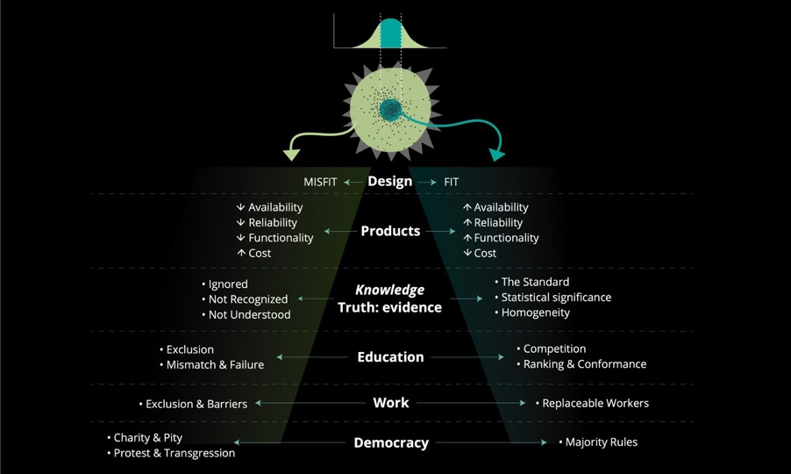
Pervasive Disparity
Notes:
.

Slide 45
Bad for the Majority

Slide 46
Reducing diversity, denying complexity

Slide 47
homogenizing toward a monoculture..

Slide 48
The prediction with the greatest probability

Slide 49
Room for Change and Growth

Slide 50
Innovation and Weak Signals
Notes:
.

Slide 51
Assumptions of Pervasively Deployed AI Hiring Tools
Past success equals future success
Optimizing data characteristics associated with past successes increases future successes
The data characteristics that determine success need not be specified or known to the operators of the AI

Slide 52
AI in Employment
Recruiting announcements
Application Filtering
Interviews and assessment
Productivity monitors and surveillance
Promotion or disciplinary actions

Slide 53
Bias toward optimal pattern = Bias against difference

Slide 54
AI getting better or more accurate = getting more discriminatory

Slide 55
Pervasive….
Employment
Academic admissions
Medical calculators & triage tools
Policing and parole
Immigration & refugee adjudication
Tax auditors….loans, mortgages…security flagging

Slide 56
Community level..
Evidence based government investment
Political platform
Public health decisions
Urban planning
Emergency preparedness, security measures…

Slide 57
Cumulative impact…
News coverage
Products marketed
GPS routes
Supply chain priority
Design features selected….

Slide 58
Bad, unfair, inaccurate decisions

Slide 59
Subject to false flagging in suspicion systems

Slide 60
Harm and incident databases
Disproportionate reports related to disability
Examples: parents with disabilities falsely flagged as unfit, false positive tax audits, false positive security flagging, excluded from optima filtering in employment and education, biased credit and asset rating, unfairly denied mortgage and loans, unfairly high insurance rates, depriortization of relevant information, iatrogenic death and illness…

Slide 61
Privacy protections don’t work
Privacy bartered for essential services
Privacy protections don’t work
Privacy protections eliminate helpful data
Recovery from data abuse & misuse absent

Slide 62
Statistical reasoning as the means of making decisions does harm

Slide 63
Assuming that what we know about the majority applies to the minority does harm

Slide 64
More than…
Addressing data gaps
Removing human bias from algorithms
Removing stereotypes from labels and proxies

Slide 65
Statistical Discrimination in AI Ethics Measures
Insignificant when determining metrics and thresholds
Invisible or insignificant in error testing (Rich Caruana)

Slide 66
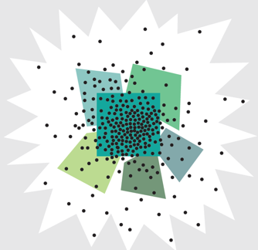
AI ethics auditing tools
Cluster analysis & comparison
No disability data cluster
Don’t detect bias against outliers or small minorities
“Falling through cracks and stranded at edges” of bounded clusters

Slide 67
Invisible in a risk-benefit framework

Slide 68
“an anomaly” “merely an anecdote”

Slide 69
Opportunity to re-think..

Slide 70
Re-thinking Human Resource Processes
Diversifying perspectives
Investing in human potential
Adaptable roles rather than replaceable workers

Slide 71
How are we addressing trustworthy AI?

Slide 72
Flipping the perspective
Focus on the novel and unique
Inverting the metrics
Addressing the needs at the edge

Slide 73
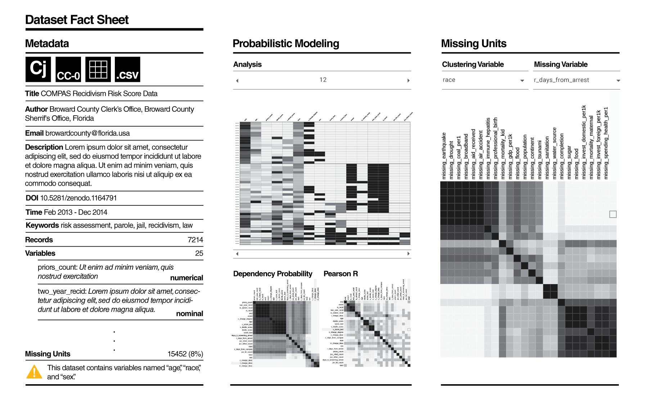
“Trust meter”
Suitability of decision system to instance before you
“Dataset nutrition label” or equivalent

Slide 74
“lawnmower of justice”

Slide 75
The “how would you do it differently” project
Chat bots for people that need them the most
Bottom-up, community driven
One-size-fits-one design

Slide 76
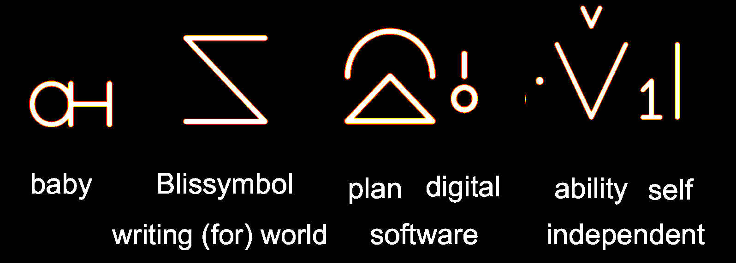
Baby Bliss Bot

Slide 77
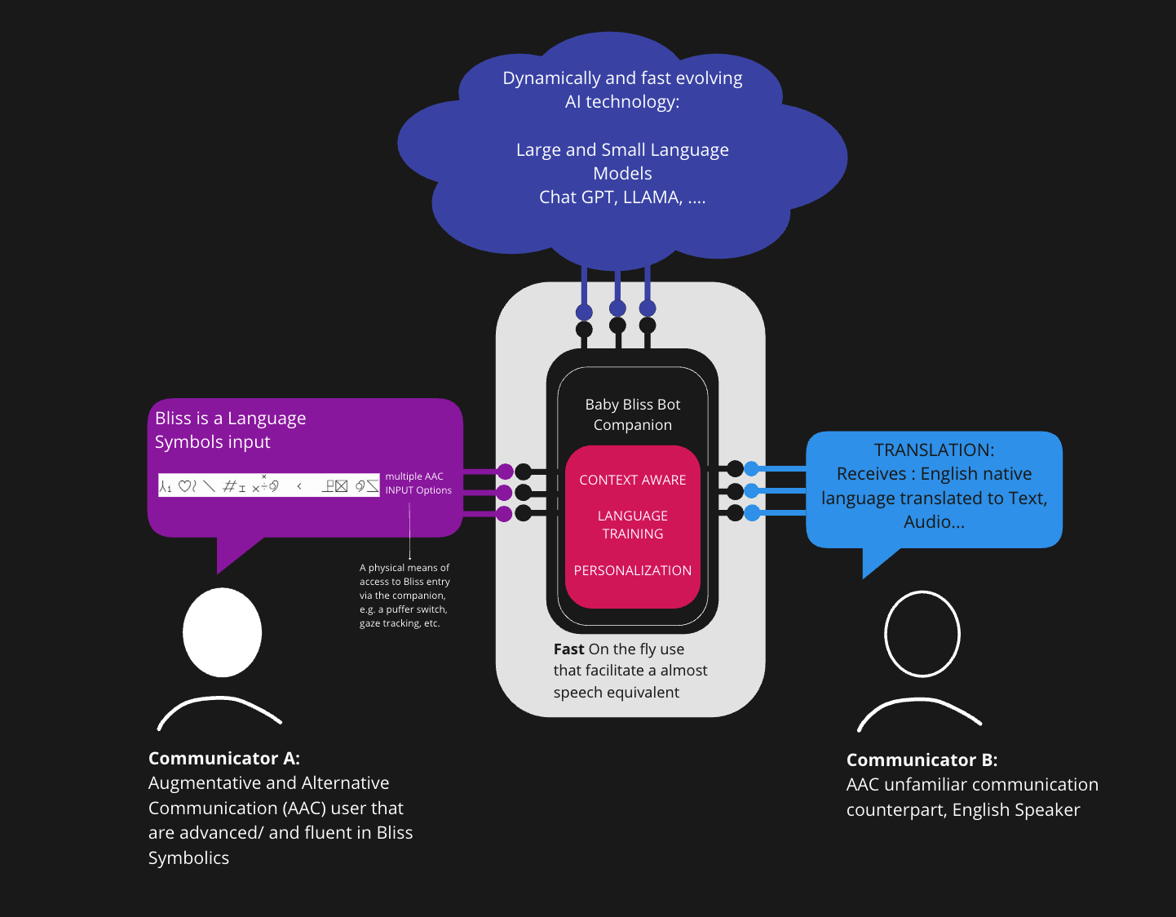
Bliss Companion

Slide 78
Mad Escapes from the grid
Technology adapting to the human rather than the human adapting to the technology
Optimizing layout, navigation, selection and correction
Leveraging all available voluntary movements

Slide 79
Accessible and Equitable AI Standard for the Accessible Canada Act

Slide 80
Specific to Disability
Accessibility: Nothing without us
Statistical discrimination
Cumulative harm
Education

Slide 81
Phase 1: 4 Parts
Accessible AI
Equitable AI
Organizational Processes that support Accessible and Equitable AI
Education

Slide 82
Capacity Building
Resources and supports to enable equity in knowledge and participation
Visualizations & case examples
Accessible Guidance document

Slide 83
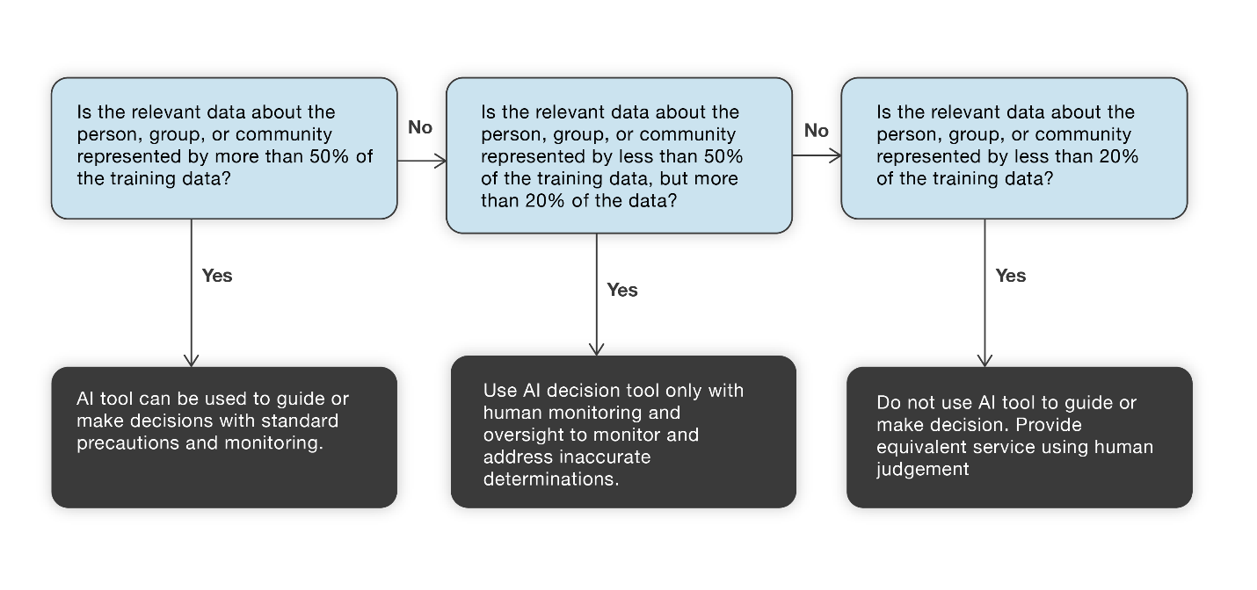
Flow Chart for Statistical Discrimination

Slide 84
… at the speed of trust

Slide 85
Accessible Canada Accessible World

Slide 86
Intelligence that works with the edge of our human scatterplot is better able to ..
Adapt to change & respond to the unexpected
Detect risk
Transfer to new contexts
Results in greater dynamic resilience & longevity
Will reduce disparity
May hold the key to our survival

Slide 87
Continuing the conversation:
https://accessible.Canada.ca
https://idrc.ocadu.ca
https://wecount.inclusivedesign.ca
@juttatrevira
https://medium.com/@jutta.trevira
Accessible Canada: Accessible World conference
Notes:
Thank you

Slide 88
Blank

